Slide 1
Processor Design
5Z032
Memory Hierarchy
Chapter 7
Henk Corporaal
Eindhoven University of Technology
2009

Slide 2
Topics
Memories: review
Memory Hierarchy: why?
Basics of caches
Measuring cache performance
Improving cache performance
Framework for memory hierarchies
Virtual memory
Pentium Pro and PowerPC 604 memory hierarchies

Slide 3
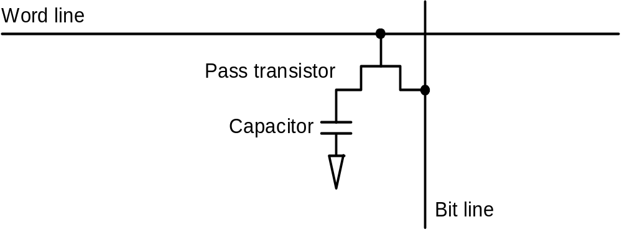
Memories: Review
SRAM:
  value is stored on a pair of inverting gates
  very fast but takes up more space than DRAM (4 to 6 transistors)
DRAM:
  value is stored as a charge on capacitor (must be refreshed)
  very small but slower than SRAM (factor of 5 to 10)

Slide 4
Memory Hierarchy, why?
Users want large and fast memories!
SRAM access times are 2 - 25ns at cost of $100 to $250 per Mbyte.
DRAM access times are 60-120ns at cost of $5 to $10 per Mbyte.
Disk access times are 10 to 20 million ns at cost of $.10 to $.20 per Mbyte.
Try and give it to them anyway
  build a memory hierarchy
1997
CPU
Level 1
Level 2
Speed
Level n
Size

Slide 5
Locality
A principle that makes having a memory hierarchy a good idea
If an item is referenced,
temporal locality: it will tend to be referenced again soon
spatial locality : nearby items will tend to be referenced soon.
Why does code have locality?
Our initial focus: two levels (upper, lower)
  block: minimum unit of data
  hit: data requested is in the upper level
  miss: data requested is not in the upper level

Slide 6

Exploiting locality
Caches

Slide 7
Cache
Two issues:
  How do we know if a data item is in the cache?
  If it is, how do we find it?
Our first example:
  block size is one word of data
  "direct mapped"
For each item of data at the lower level,
there is exactly one location in the cache where it might be.
e.g., lots of items at the lower level share locations in the upper level

Slide 8
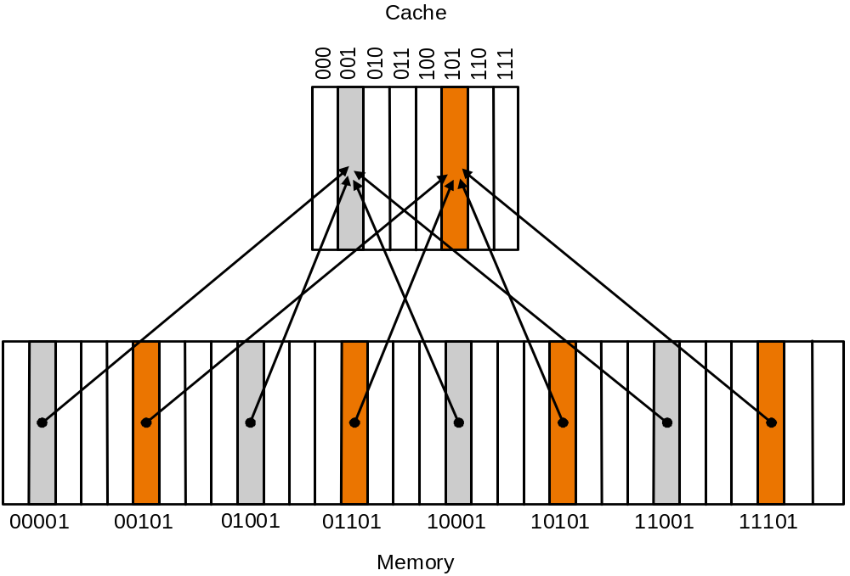
Direct Mapped Cache
Mapping: address is modulo the number of blocks in the cache

Slide 9
Direct Mapped Cache
Address (bit positions)
3
1
3
0
1
3
1
2
1
1
2
1
0
For MIPS:
What kind of locality are we taking advantage of?
o
B
y
t
e
f
f
s
e
t
H
i
t
2
0
1
0
D
a
t
a
T
a
g
I
n
d
e
x
I
n
d
e
x
V
a
l
i
d
T
a
g
D
a
t
a
0
1
2
1
0
2
1
1
0
2
2
1
0
2
3
2
0
3
2

Slide 10
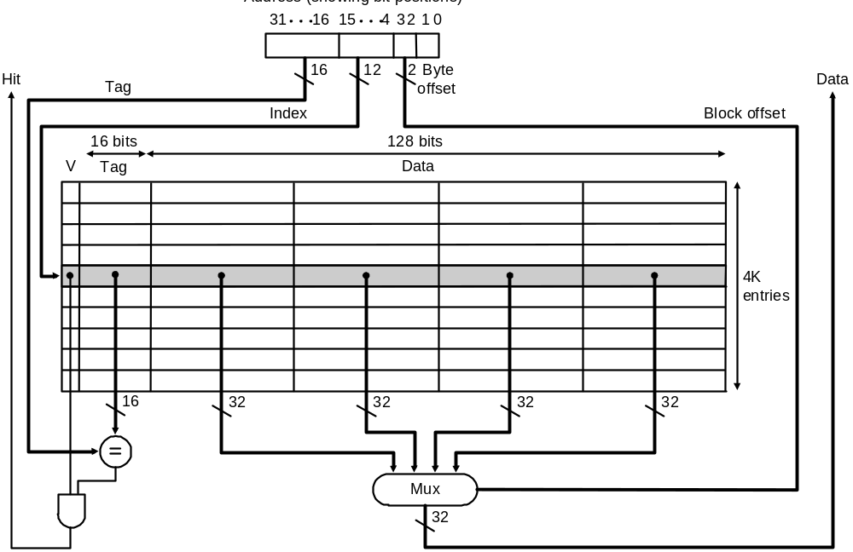
Direct Mapped Cache
Taking advantage of spatial locality:
Address (bit positions)

Slide 11
Hits vs. Misses
Read hits
  this is what we want!
Read misses
  stall the CPU, fetch block from memory, deliver to cache, restart the load instruction
Write hits:
  can replace data in cache and memory (write-through)
  write the data only into the cache (write-back the cache later)
Write misses:
  read the entire block into the cache, then write the word (allocate on write miss)
  do not read the cache line; just write to memory (no allocate on write miss)

Slide 12
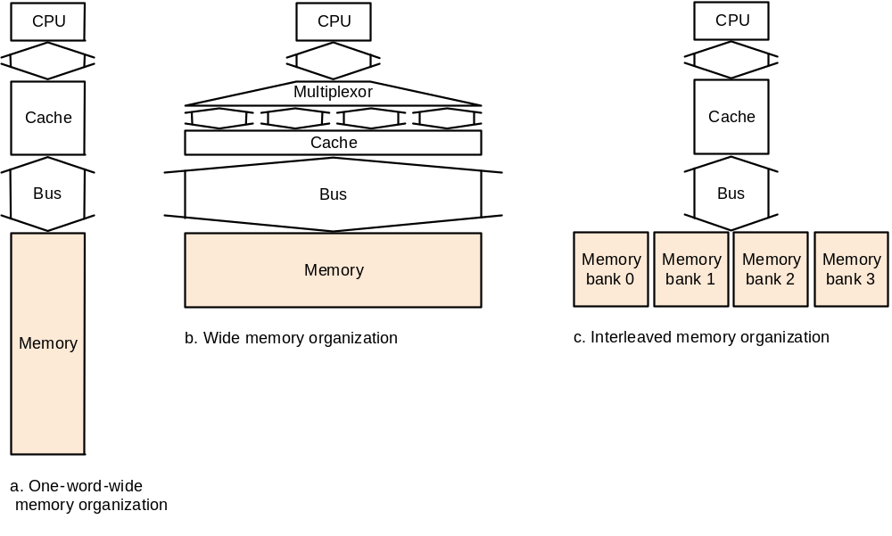
Hardware Issues
Make reading multiple words easier by using banks of memory
It can get a lot more complicated...

Slide 13
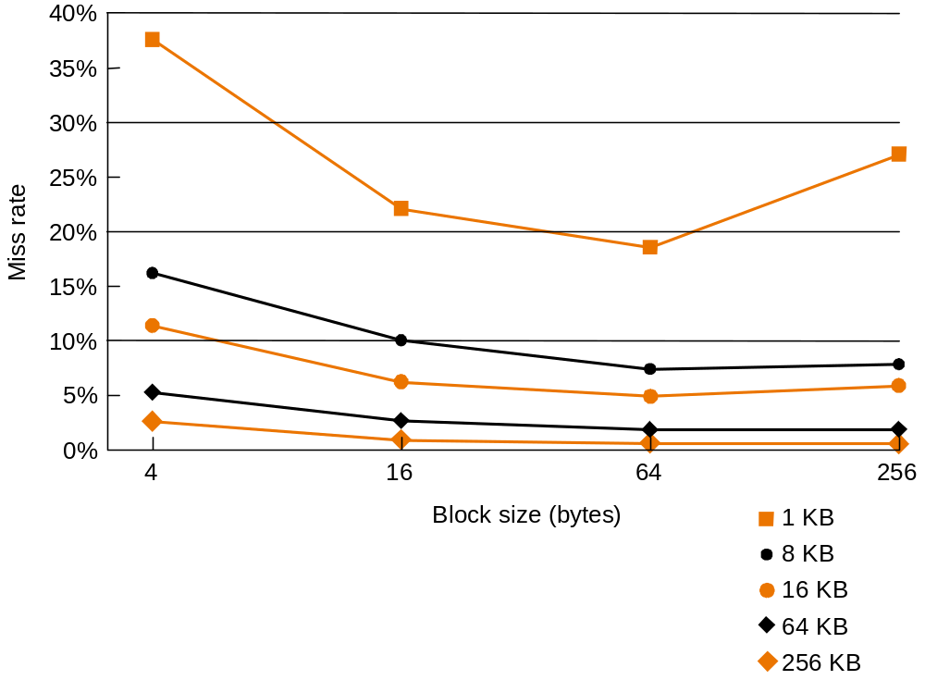
Performance
Increasing the block size tends to decrease miss rate:

Slide 14
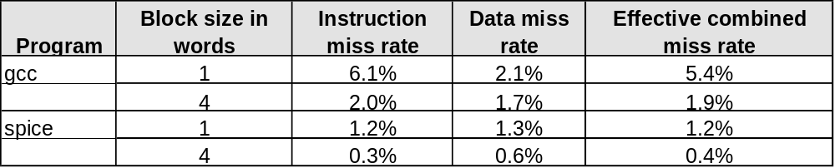
Performance
Use split caches because there is more spatial locality in code:

Slide 15
Performance
Simplified model:
execution time = (execution cycles + stall cycles) × cycle time
stall cycles = # of instructions × miss rate × miss penalty

Slide 16
Performance
T_{exec} = N_{inst}• CPI • T_{cycle}
with
CPI = CPI_{ideal} + CPI_{stall}
CPI_{stall} = %reads • missrate_{read} • misspenalty_{read}+
%writes • missrate_{write} • misspenalty_{write}
or:
T_{exec} = (N_{normal-cycles} + N_{stall-cycles} ) • T_{cycle}
with
N_{stall-cycles} = N_{reads} • missrate_{read} • misspenalty_{read}+
N_{writes} • missrate_{write} • misspenalty_{write}
(+ Write-buffer stalls )

Slide 17
Performance example
Assume GCC application (pg 311)
  Icache missrate 2%
  Dcache missrate 4%
  CPI ideal is 2.0
  Misspenalty 40 cycles
Calculate CPI
CPI = 2.0 + CPIstall
CPIstall = Instruction-miss cycles + Data-miss cycles
Instruction-miss cycles = Ninstr x 0.02 x 40 = 0.80 Ninstr
Data-miss cycles = Ninstr x %ld-st x 0.04 x 40
%ld-st = 36 %
Slowdown: 1.68 !!

Slide 18
Performance example (cont’d)
What if ideal processor had CPI = 1.0 (instead of 2.0)
Slowdown would be 2.36 !
What if processor is clocked twice as fast
=> penalty becomes 80 cycles
CPI = 4.75
Speedup = N.CPIa.Tclock / (N.CPIb.Tclock/2) =
3.36 / (4.75/2)
Speedup is not 2, but only 1.41 !!

Slide 19
Improving performance
Two ways of improving performance:
  decreasing the miss ratio: associativity
  decreasing the miss penalty: multilevel caches
What happens if we increase block size?

Slide 20
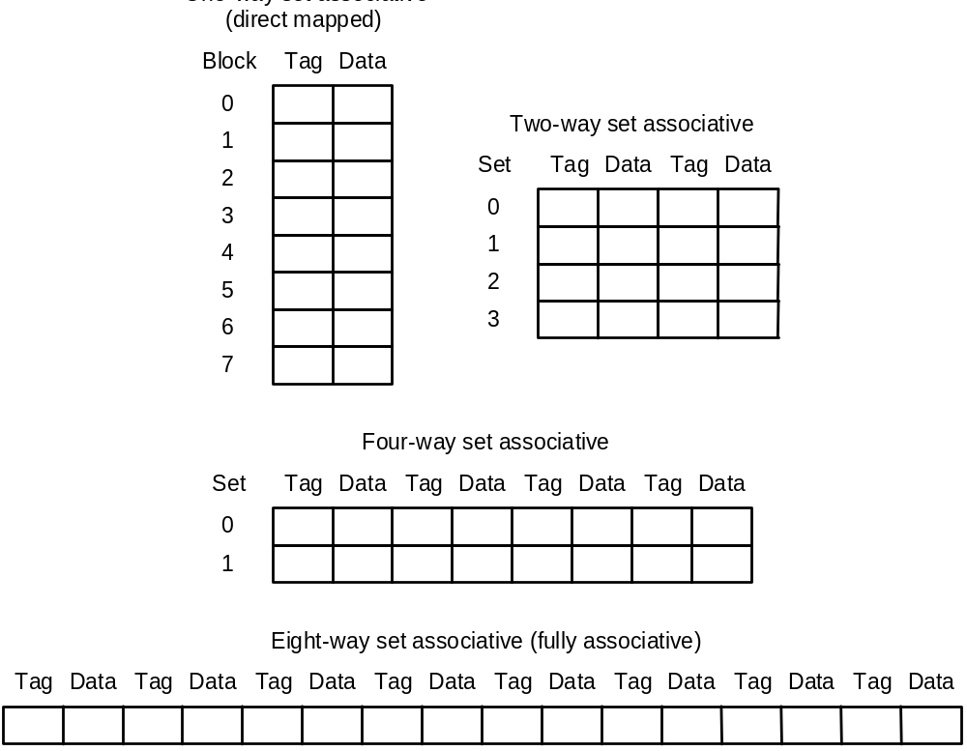
Decreasing miss ratio with associativity
2 blocks / set
block
4 blocks / set
8 blocks / set

Slide 21
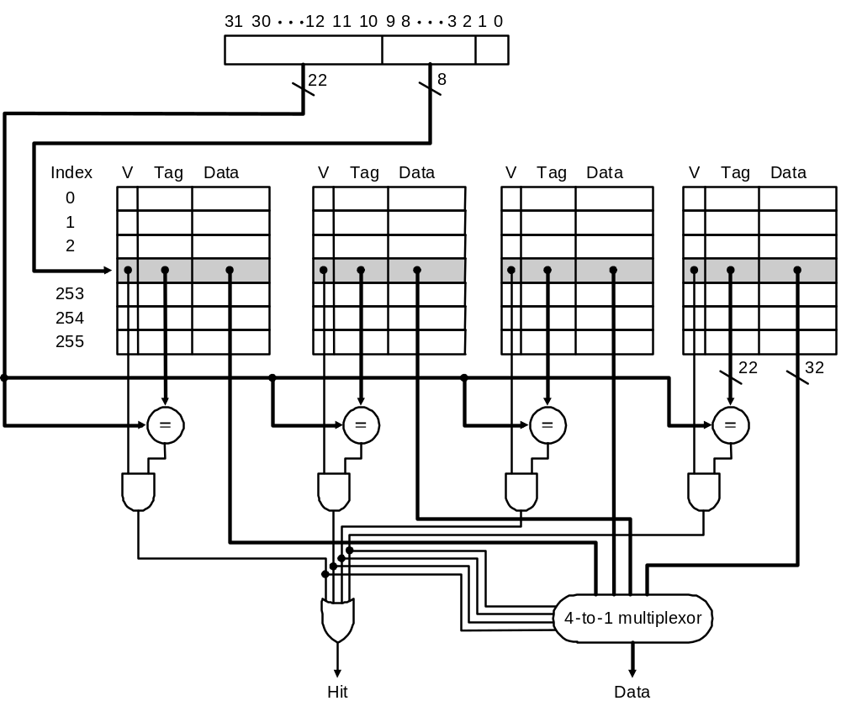
An implementation: 4 way associative

Slide 22
Decreasing miss ratio with associativity
Exercise
Compared to direct mapped, give a series of references that:
  results in a lower miss ratio using a 2-way set associative cache
  results in a higher miss ratio using a 2-way set associative cache
assuming we use the “least recently used” (LRU) replacement strategy

Slide 23
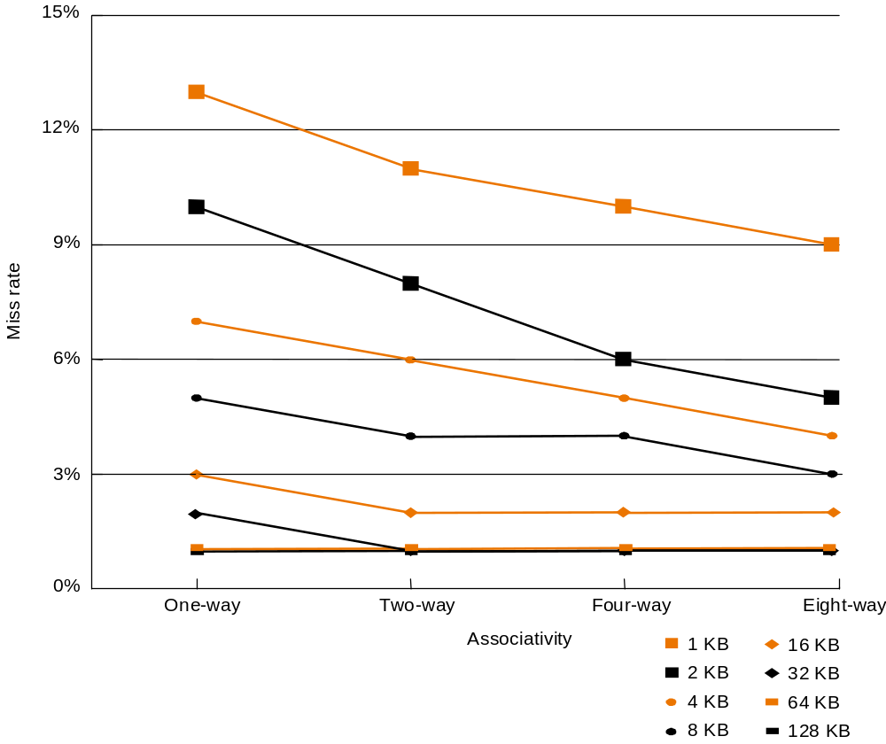
Performance
1 KB
2 KB
8 KB

Slide 24
Decreasing miss penalty with multilevel caches
Add a second level cache:
  Often primary cache is on the same chip as the processor
  Use SRAMs to add another cache above primary memory (DRAM)
  Miss penalty goes down if data is in 2nd level cache
Example:
  Base CPI of 1.0 on a 500Mhz machine with a 5% miss rate, 200ns DRAM access
  Adding 2nd level cache with 20ns access time decreases miss rate to 2%
  Q. How much faster will this machine become?
Using multilevel caches:
  Try and optimize the hit (access) time on the 1st level cache
  Try and optimize the miss rate on the 2nd level cache

Slide 25
Virtual Memory
The illusion of one big (protected) memory

Slide 26
Why virtual memory
Each program has a separate address space
Protection
  Read-only pages
  Executable pages
  Shared pages
Illusion of big memory
Supported by MMU: memory management unit

Slide 27
Memory organization
The operating system, together with the MMU hardware, take care of separating the programs.
Each program runs in its own ‘virtual’ environment, and uses logical addressing that is (often) different the the actual physical addresses.
Within the virtual world of a program, the full 4 Gigabytes address space is available. (Less under Windows)
In the von Neumann architecture, we need to manage the memory space to store the following:
  The machine code of the program
  The data:
    Global variables and constants
    The stack/local variables
    The heap
Main memory
Program
+
Data

Slide 28
Memory Organization: more detail
The memory that is reserved
by the memory manager
0xFFFFFFFF
Heap
Variable
size
If the heap and the
stack collide, we’re out
of memory
The local variables in the
routines. With each routine
call, a new set of variables
if put in the stack.
Free memory
Stack pointer
Before the first line
of the program is run,
all global variables and
constants are initialized.
Variable
size
Stack
Global variables
Fixed
size
The program itself:
a set of machine
instructions.
This is in the .exe
Machine code
Fixed
size
0x00000000

Slide 29
Memory management
Problem: many programs run simultaneously
MMU manages the memory access.
Swap file
on
hard disk
Memory Management Unit
Main memory
No: access
violation
2K block
No: load 2K block
from swap file
on disk
2K block
CPU
Logical
address
Process
table
Yes:
Virtual
Memory
Manager
2K block
Physical
address
2K block
2K block
Yes:
Physical
address
Physical
address
Cache
memory
2K block
2K block
2K block
Each program thinks
that it owns all the
memory.
Checks whether the
requested address
is ‘in core’

Slide 30
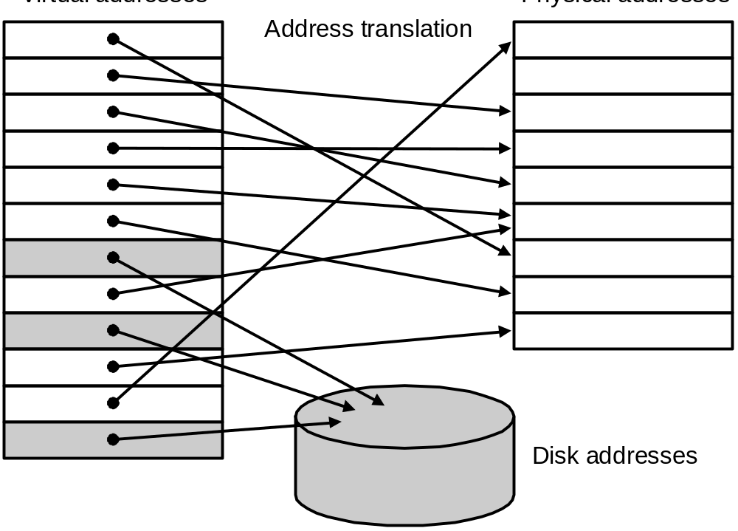
Virtual Memory
Main memory can act as a cache for the secondary storage (disk)
virtual memory
physical memory
Advantages:
  illusion of having more physical memory
  program relocation
  protection

Slide 31
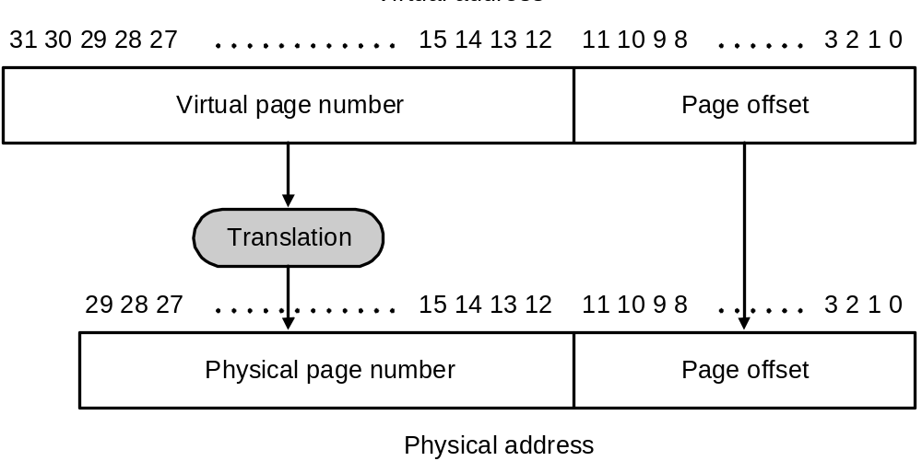
Pages: virtual memory blocks
Page faults: the data is not in memory, retrieve it from disk
  huge miss penalty, thus pages should be fairly large (e.g., 4KB)
  reducing page faults is important (LRU is worth the price)
  can handle the faults in software instead of hardware
  using write-through is too expensive so we use writeback

Slide 32
Page Tables
V
i
r
t
u
a
l
p
a
g
e
n
u
m
b
e
r
P
a
g
e
t
a
b
l
e
P
h
y
s
i
c
a
l
m
e
m
o
r
y
P
h
y
s
i
c
a
l
p
a
g
e
o
r
V
a
l
i
d
d
i
s
k
a
d
d
r
e
s
s
1
1
1
1
0
1
1
0
1
D
i
s
k
s
t
o
r
a
g
e
1
0
1

Slide 33
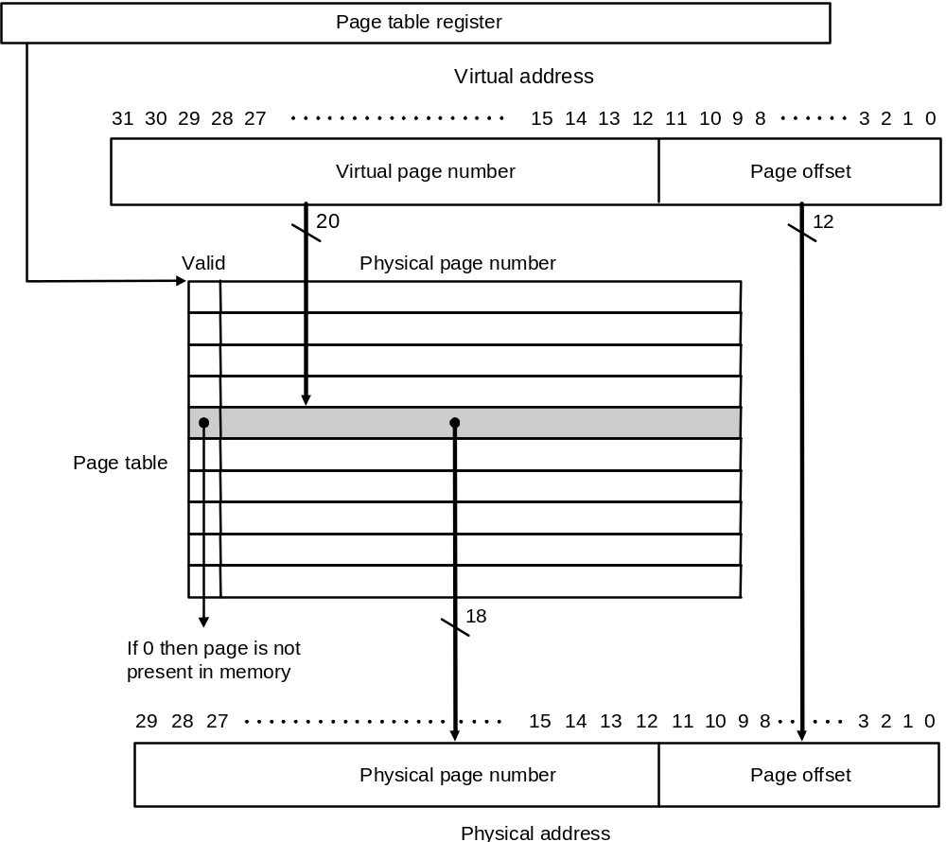
Page Tables

Slide 34
Size of page table
Assume
  40-bit virtual address; 32-bit physical
  4 Kbyte pages; 4 bytes per page table entry
Solution
  Size = N_{entries} * Size-of-entry = 2 ⁴⁰ / 2 ¹² * 4 bytes = 1 Gbyte
Reduce size:
  Dynamic allocation of page table entries
  Hashing: inverted page table
    1 entry per physical available instead of virtual page
  Page the page table itself (i.e. part of it can be on disk)
  Use larger page size (multiple page sizes)

Slide 35
Making Address Translation Fast
A cache for address translations: translation lookaside buffer (TLB)
TLB
Virtual page
number
Valid Tag Page address
1
1
Physical memory
1
1
0
1
Physical page
or disk address
Valid
Page table
1
1
Disk storage
1
1
0
1
1
0
1
1
0
1

Slide 36
TLBs and caches
V
i
r
t
u
a
l
a
d
d
r
e
s
s
T
L
B
a
c
c
e
s
s
T
L
B
m
i
s
s
N
o
T
L
B
h
i
t
?
Y
e
s
e
x
c
e
p
t
i
o
n
P
h
y
s
i
c
a
l
a
d
d
r
e
s
s
N
o
W
r
i
t
e
?
Y
e
s
T
r
y
t
o
r
e
a
d
d
a
t
a
f
r
o
m
c
a
c
h
e
N
o
W
r
i
t
e
a
c
c
e
s
s
Y
e
s
b
i
t
o
n
?
W
r
i
t
e
p
r
o
t
e
c
t
i
o
n
W
r
i
t
e
d
a
t
a
i
n
t
o
c
a
c
h
e
,
e
x
c
e
p
t
i
o
n
u
p
d
a
t
e
t
h
e
t
a
g
,
a
n
d
p
u
t
C
a
c
h
e
m
i
s
s
s
t
a
l
l
N
o
C
a
c
h
e
h
i
t
?
Y
e
s
t
h
e
d
a
t
a
a
n
d
t
h
e
a
d
d
r
e
s
s
i
n
t
o
t
h
e
w
r
i
t
e
b
u
f
f
e
r
D
e
l
i
v
e
r
d
a
t
a
t
o
t
h
e
C
P
U

Slide 37
Overall operation of memory hierarchy
Each instruction or data access can result in three types of hits/misses: TLB, Page table, Cache
Q: which combinations are possible?
Check them all!
TLB | Page table | Cache | Possible?
hit | hit | hit | Yes, but .....
hit | hit | miss
hit | miss | hit
hit | miss | miss
miss | hit | hit
miss | hit | miss
miss | miss | hit
miss | miss | miss

Slide 38
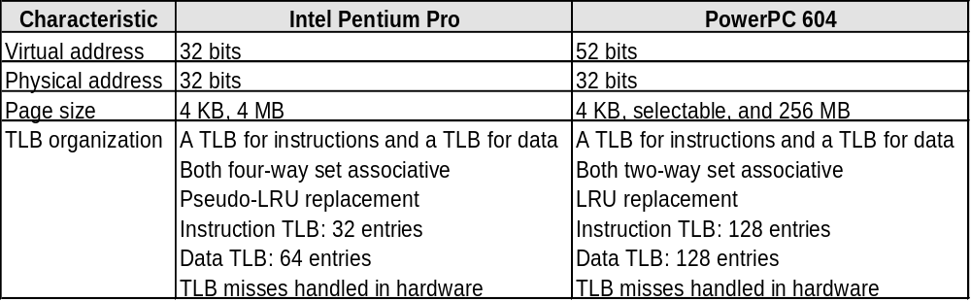
Modern Systems
Very complicated memory systems
  multiple levels of cache
  separate L1 data and instruction caches
  writeback buffer
  prefetching
  hit under miss
  ....
Virtual memory examples:

Slide 39
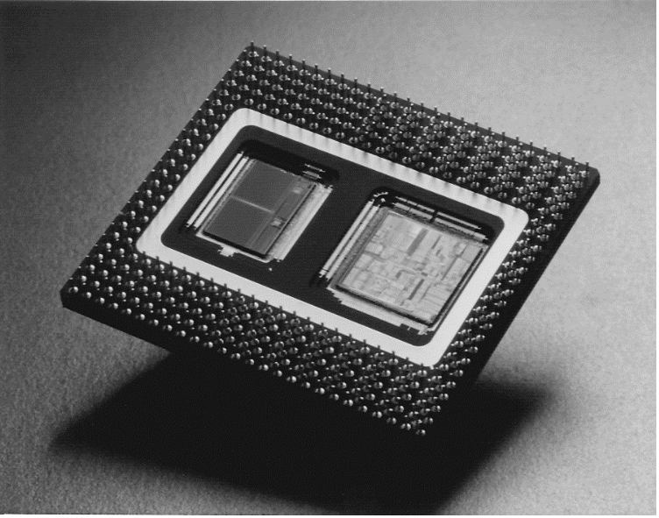
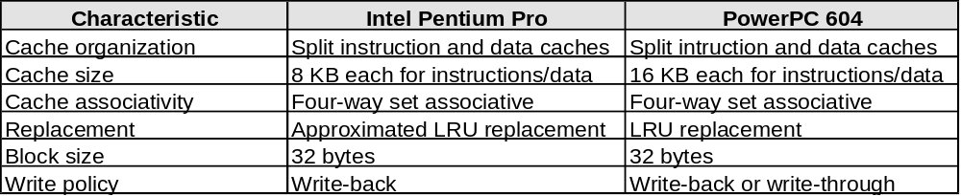
Modern Systems
First level Cache organization
Pentium Pro dual
chip module

Slide 40
Common framework for memory hierarchies
Answer the following 4 questions for each memory level
(registerfile, Li-cache, virtual memory)
Q1: where can a block be placed?
Q2: how is a block found?
Q3: wich block should be replaced on a miss?
Q4: what happens on a write?
Let’s answer this for a cache
(try yourself for registers and virtual memory)

Slide 41
Common framework for memory hierarchies
Q1: where can a block be placed?
  note: a block is in this case a cache line
Direct mapped cache: one position
n-way set-associative cache: n positions (typically 2-8)
Fully associative: everywhere
Q2: how is a block found?
Direct mapped: index part of address indicates entry
n-way: use index to search in all the n cache blocks
Fully associative: check all tags

Slide 42
Common framework for memory hierarchies
Q3: wich block should be replaced on a miss?
Direct mapped: no choice
Associative caches: use replacement algorithm, like LRU
Q4: what happens on a write?
write-through ⇔ write-back
on a write miss: allocate ⇔ no-allocate
Q: Which combinations
make sense?
 | write-through | write-back
no-allocate on write miss
allocate on write miss

Slide 43
Common framework for memory hierarchies
Understanding (cache) misses:The three Cs
Compulsory miss
Capacity miss
Conflict miss
direct mapped (1-way)
miss rate
2-way
4-way
fully associative
capacity
compulsory
cache size

Slide 44
Future
Processor speeds continue to increase very fast
  much faster than either DRAM or disk access times
Processing
Performance
55 %/y
Performance
gap
35 %/y
Memory
7 %/y
70
80
90
00
10
Year
Design challenge: dealing with this growing disparity
Trends:
  SDRAM, DDR, RambusDRAM,...
  restructure code to increase locality
  use prefetching (make cache visible to ISA)

Slide 45
Exercises
From Chapter seven:
7.2, 7.3
7.7 - 7.10
7.20, 7.21
7.27, 7.32

